Slide 1
Evaluating cell lines as tumor models by comparison of genomic profiles
Domcke, S. et al. Nat. Commun 4:2126

Slide 2
Motivation
Problem: Genomic differences between cancer cell lines and tissue samples
TCGA and CCLE provide molecular profiles for tumor samples and cell lines
Compared high-grade serous ovarian cancer (HGSOC) to genomic profiles to identify suitable cell lines for in vitro models
Notes:
Cell lines from tumors are most commonly-used models in research
It has been pointed out before in many studies that there are genomic differences between cancer cell lines and tumor samples
Difficult to find cell lines that closely resemble genomic alterations of given tumor subtype
TCGA – The Cancer Genome Atlas: has genome and expression profiles of at least 500 tissue samples per tumor type
CCLE – Cancer Cell Line Encyclopedia: contains genomic profiles of 1,000 cell lines that are used as models for various tumor types
Can do systematic comparison off tumors and cell lines at level of DNA copy number, mutation and mRNA expression data across tumor types

Slide 3
Ovarian Cancer
Over 100,000 women die of ovarian cancer each year
5th leading cause of cancer death
Divided into 4 major histological subtypes:
  Serous (study’s focus)
  Endometrioid
  Clear Cell
  Mucinous carcinoma
Notes:
Serous ovarian carcinoma is responsible for 70% of epithelial ovarian cancers.
The most aggressive subtype, HGSOC, accounts for 90% of these serous carcinomas and two-thirds of all ovarian cancer deaths
Most extensively studied ovarian carcinoma

Slide 4
Common cell line models for ovarian cancer and HGSOC are: SK-OV-3, A2780, OVCAR-3, CAOV3 and IGROV1
Need for well-characterized cell line models for cell types
Found differences between most common models and majority of HGSOC samples
Notes:
All histological subtypes were believed to arise from the ovarian surface epithelium
Histopathological origin unclear
However, found that the majority of invasive tumors may originate from different non-ovarian tissues- ovarian cancer is extremely heterogeneous

Slide 5
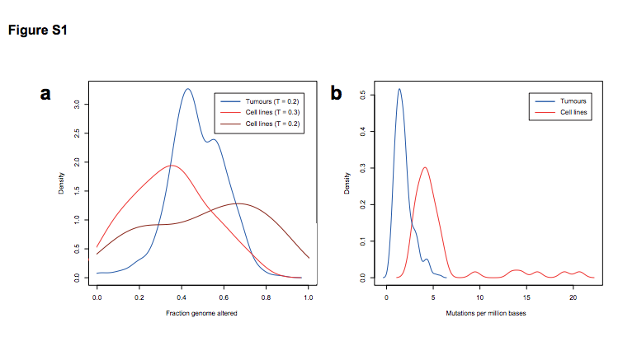
Notes:
Figure from supplemental material:
- Compares copy-number alteration and mutation frequencies for all 316 samples of HGSOC tumor samples and
47 ovarian cancer cell lines
- The distribution for the cell line panel is much wider- this is because there are many subtypes of ovarian cancer, which differ in copy-number status
Shows a wide distribution and outliers in cell lines
In figure 1b, there were more mutations found in the cell lines than the tumors

Slide 6

Analyzed 316 HGSOC tumor samples from TCGA and 47 ovarian cancer cell lines from CCLE
DNA copy-number, mutation and mRNA expression data
Fraction genome altered (FGA):
CN=log2(sample intensity/reference intensity)
L(i) is length of segment i
T is threshold value of Cn_{i} above which segments are altered
- T= 0.2 for TCGA samples
- T=0.3 for CCLE cell lines
Notes:
For the remaining ovarian cancer cell lines, COLO684, TOV112D, OC314 and OC315, not all three data types were available from the CCLE, so they were excluded from the analysis.
Different thresholds were used for tumors and cell lines because copy number signal tumors is weakened due to contamination with non-tumor material or tumor heterogeneity
Whereas cell lines are more pure

Slide 7
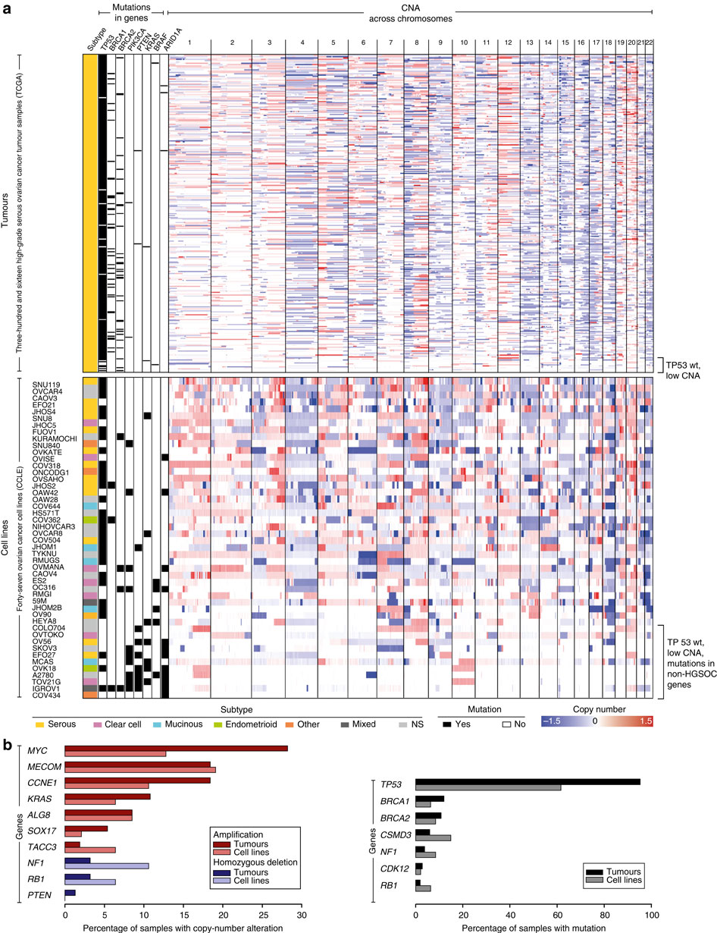
Notes:
Figure 1: Genomic comparison of tumor samples with ovarian cancer cell lines suggests overall genetic similarity
They are sorted in decreasing fraction of the genome altered in DNA copy number

Slide 8
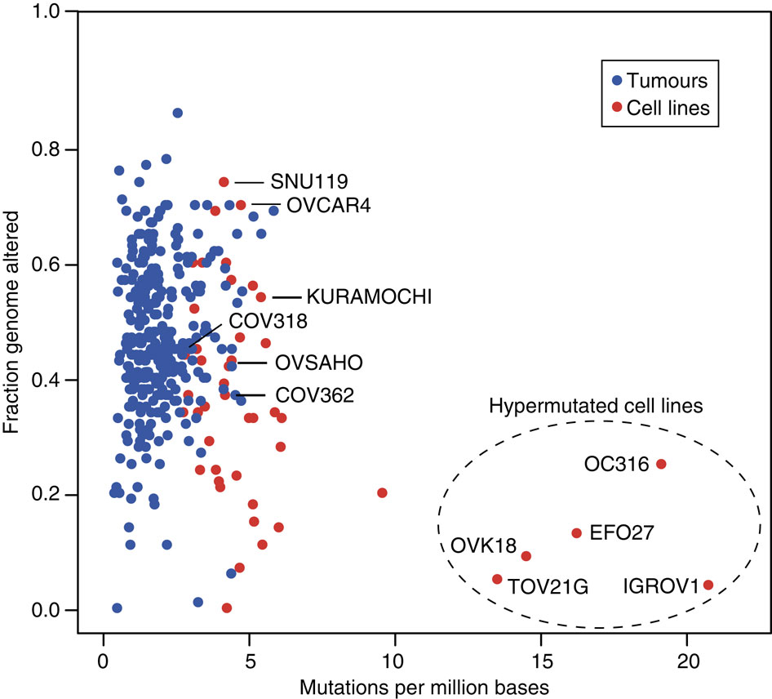
Notes:
Figure 2 – Hypermutated cell lines are outliers
Found that the cell lines have a slightly more mutations than the tumor samples, but have a similar degree of CNA’s
The outliers have few CNA’s and many more mutations – called the hypermutator genotype

Slide 9
Suitability of HGSOC Models
S = A + B – 2×C – D/7
A = Correlation with mean CNA of tumors
B = 1 for cell lines with TP53 mutation or else 0
C = 1 for hypermutated cell line or else 0
D = # of genes mutated in 7 “non-HGSOC” genes
Notes:
- Calculated an empirical numerical score to see which ovarian cancer cell lines match genetic characteristics shared by TGCA tumors
S is the suitability score, in which selected features of HGSOC are positively weighted and traits of other subtypes are negatively weighted
Distinguish better and poor cell line models

Slide 10
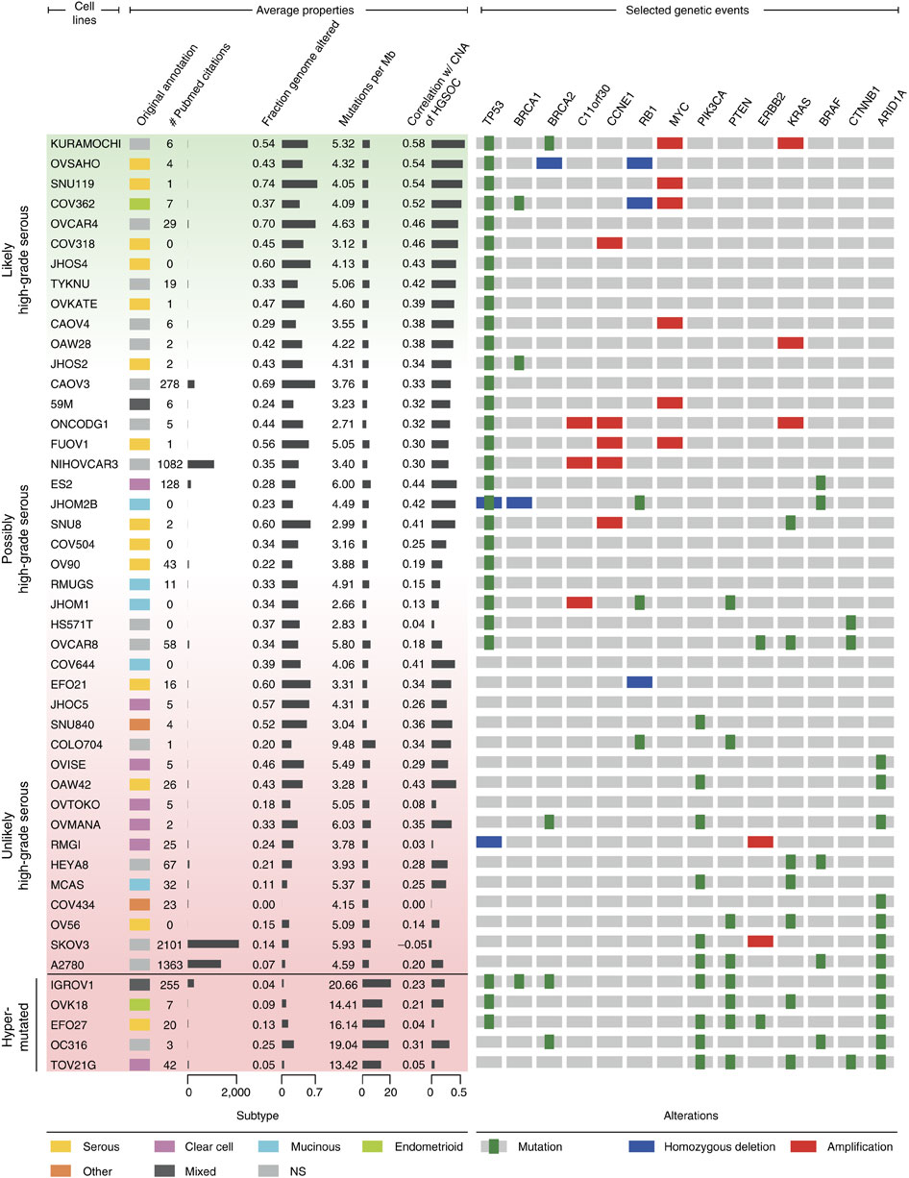
Notes:
Figure 3: Ranking ovarian cancer cell lines by suitability as HGSOC models
Can rank cell lines from most suitable to least suitable
Right: alterations similar to HGSOC such as TP53 and BRCA1/2 and amplifications for comparison
Cell lines near the top are the better suited in vitro models for HGSOC – share major characteristics
They have a TP53 mutation, which is characteristic of HGSOC
Highest suitability score was KURAMOCHI
Cell lines were from 13 years ago and we not derived from primary tumors in the ovary, but from peritoneal deposits – tissue lining the abdomen

Slide 11
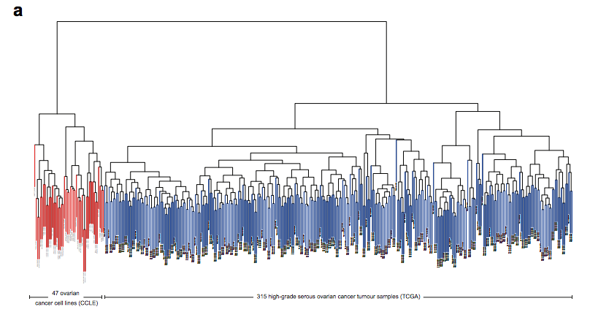
Notes:
- From supplementary material
- 5000 most variable genes were used in unsupervised clustering of cell lines and tumors by mRNA expression for hierarchal ordering
Similar to previous paper
Can see that cell lines and tumor samples cluster very far apart

Slide 12
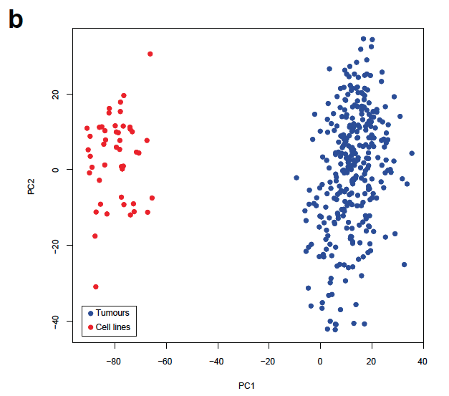
Notes:
- From the last paper that introduced principal component analysis, this figure is showing expression data from 47 ovarian cancer cell lines in red a
and 315 tumor samples from TCGA, using the 5,000 most variable genes.
- Clear division between cell lines and tumors

Slide 13
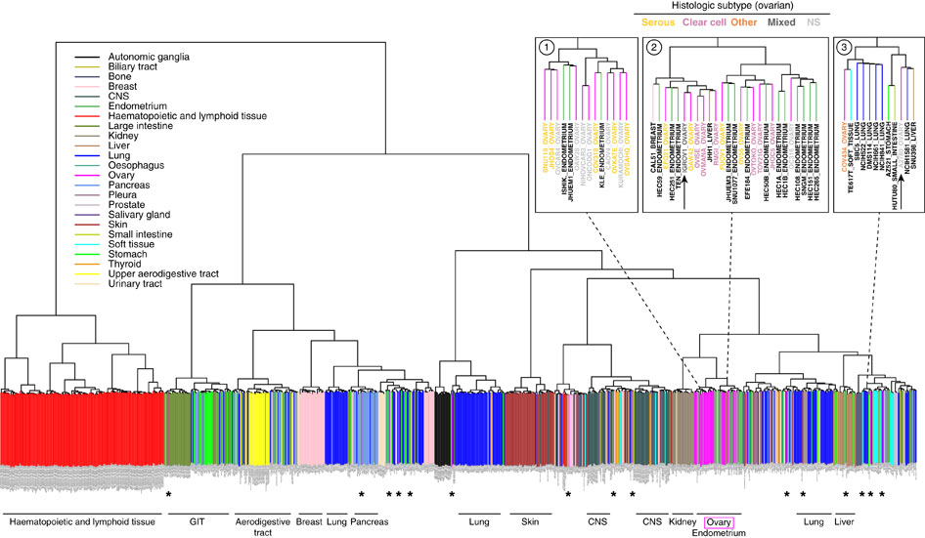
Notes:
Figure 4: Expression-based clustering of all 963 CCLE cell lines from diverse tumor types
Unsupervised clustering of cell lines by mRNA expression data
Groups cell lines according to tissue of origin
At the top, there is an arrow pointing to IGROV
Found that it clusters with endometrial and clear cell ovarian cancer instead of high grade serous
Finding that several ovarian tumors don’t originate in this organ but come from distant primary tumors
Did find that KURAMOCHI clusters with HGSOC types – making it a suitable model

Slide 14
Future Directions
Drug response profiles using accurate cell line models with known alterations for patient selection in clinical trials
Perform preclinical drug screens for more-informed patient therapy
Any others?

